Slide 1
Computer Networks and Internets
《计算机网络与因特网》课件
林坤辉

Slide 2
PART IV Internetworking
Chapter 20（1）
Internetworking:
Concepts,Architecture,and Protocols
网络互联：概念、结构与协议

Slide 3

20.2 The Motivation for Internetworking
Each network technology is designed to fit a specific set of constraints.
LAN technologies(e.g., Ethernet).
WAN technologies (e.g., Frame Relay).
No single networking technology is best for all needs.
A large organization with diverse networking requirements needs multiple physical networks.

Slide 4
20.3 The Concept of Universal Service通用服务概念
A computer attached to a given network can only communicate with other computers attached to the same network.
Each network in the organization formed an island.
Users must use a separate computer for each network.
Universal service(通用服务) allows arbitrary pairs of computers to communicate.

Slide 5
20.4 Universal Service In A Heterogeneous World
异构世界中的通用服务
Electrical incompatibilities among network hardware.
Different technologies use incompatible packet formats and addressing scheme.
A frame created for one network technology cannot be transmitted on a network that uses a different technology.

Slide 6
20.5 Internetworking
Called internetworking, the scheme uses both hardware and software.
Additional hardware systems are used to interconnect a set of physical network.
Software on all the attached computers then provides universal service.
The resulting system of connected physical networks is known as an internetwork or internet.

Slide 7

20.6 Physical Network
Connection With Routers
用路由器连接物理网
The basic hardware component used to connect heterogeneous network is a router .

Slide 8

20.7 Internet Architecture
互联网体系结构
A internet consists of a set of networks interconnected by routers .

Slide 9
20.8 Achieving Universal service
To provide universal service among all computers on an internet,
Routers must agree to forward information from a source on one network to a specified destination on another.

Slide 10
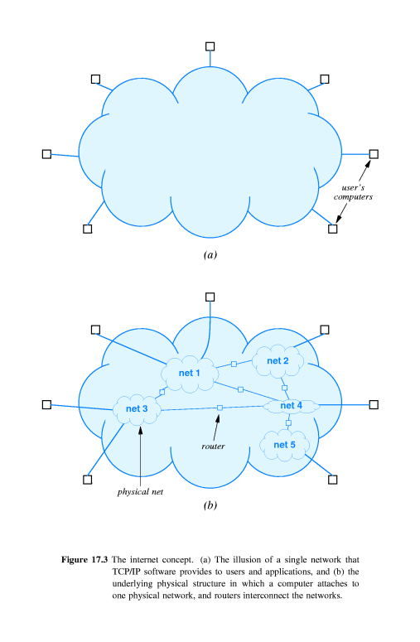
20.9 A Virtual Network 虚拟网络
an internet is a virtual network system.

Slide 12
20.10 Protocols For Internetworking
Work on TCP/IP began in the 1970s.
TCP/IP was the first set of protocols developed for use in an internet.

Slide 13
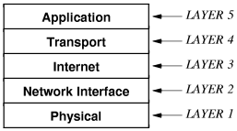
20.12 Layering and TCP/IP Protocols
TCP/IP layering model,or Internet layering Model, or Internet Reference Model.

Slide 14
20.13 Host computers, Routers, and Protocol Layers
Host computer to refer to any computer system that connects to an internet and runs applications.
Both hosts and routers need TCP/IP protocol software.
Routers do not use protocols from all layers.

Slide 15
作业
理解TCP/IP协议的层次结构和各层功能，比较与ISO/OSI参考模型的异同。
TCP/IP网络体系结构为什么要保证网络层的协议一致。

